Slide 2
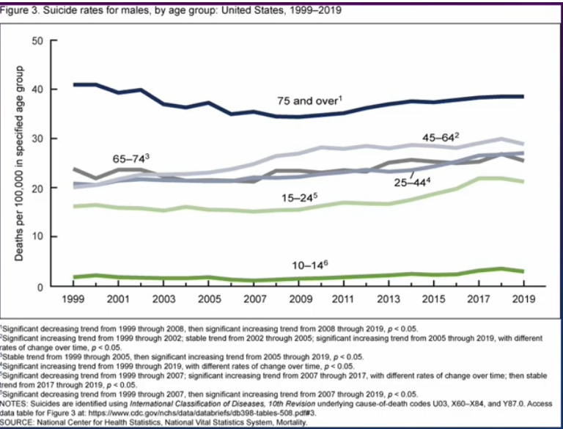

Slide 3
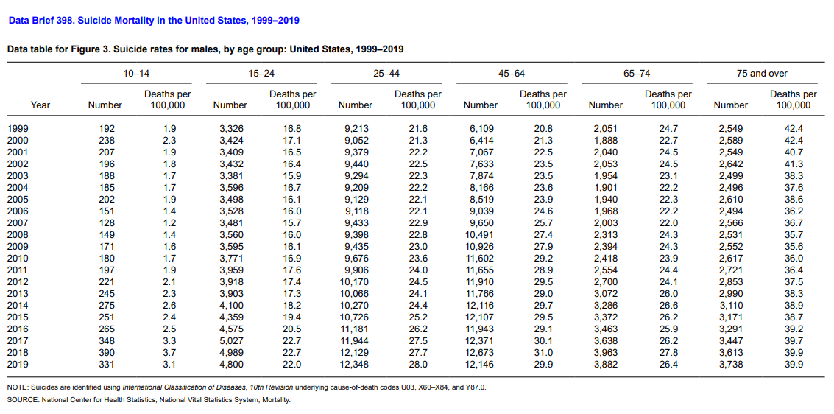

Slide 10
Additional resources for Michigan Masons

